Slide 1
FAINAL PROJECT
CIT COURSE

Slide 2
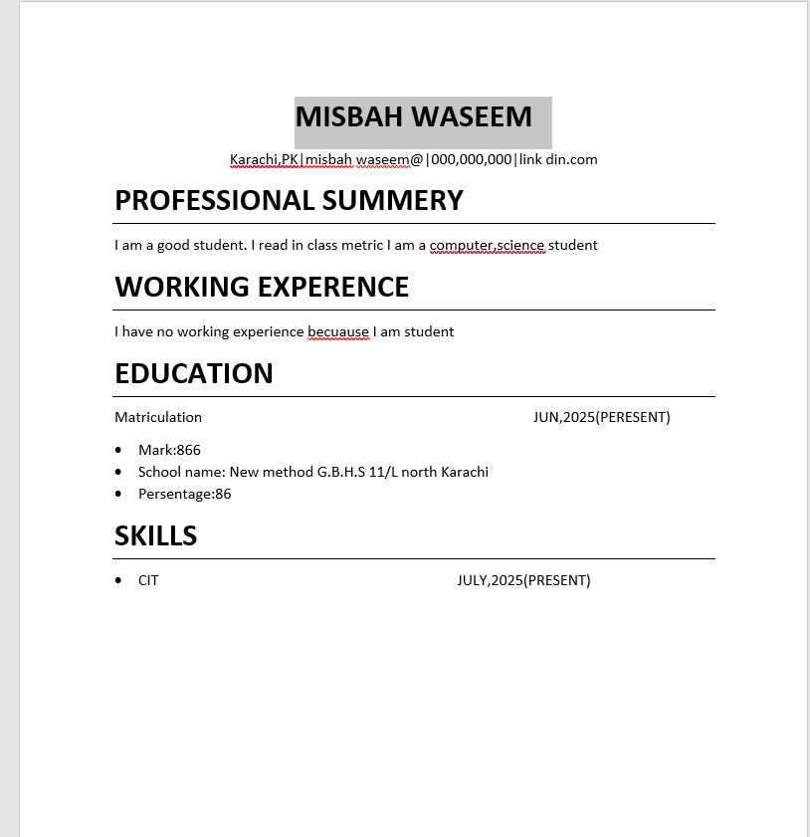
resume
I am open word and I select blank page . I am a decide my cv is simple and professional and select readable font include relevant details Professional summary ,Education , Skills , Experience unnecessary information not include and include proper heading proper spacing our alignment , Bullet point contact details on top overall design simple and professional and again cv read.

Slide 3
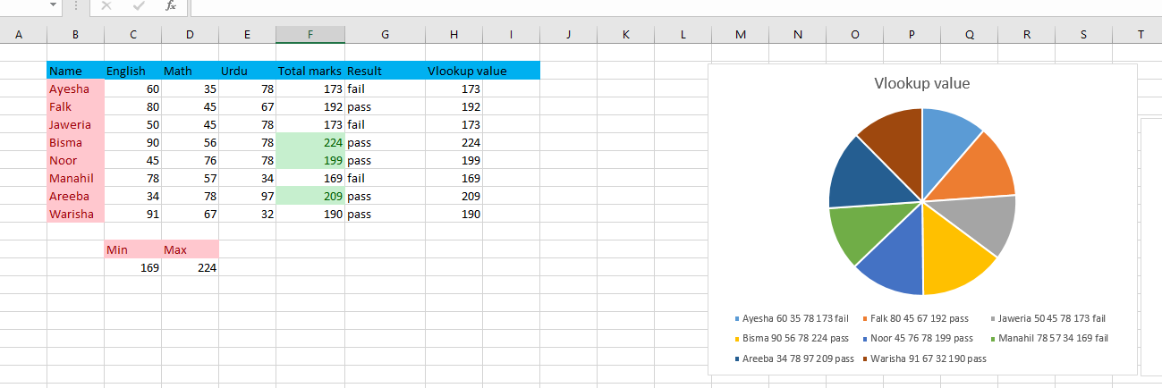
.
The VLOOKUP function in Excel (and other spreadsheet programssed to search for a value in the first column of a table or range, and return a value in the same row from another column. It’s a great tool for looking up data quickly, like finding a product price, employee info, or other related data.

